Slide 1

Data Modeling with Core Data Services

Slide 2
Day 1

Slide 3
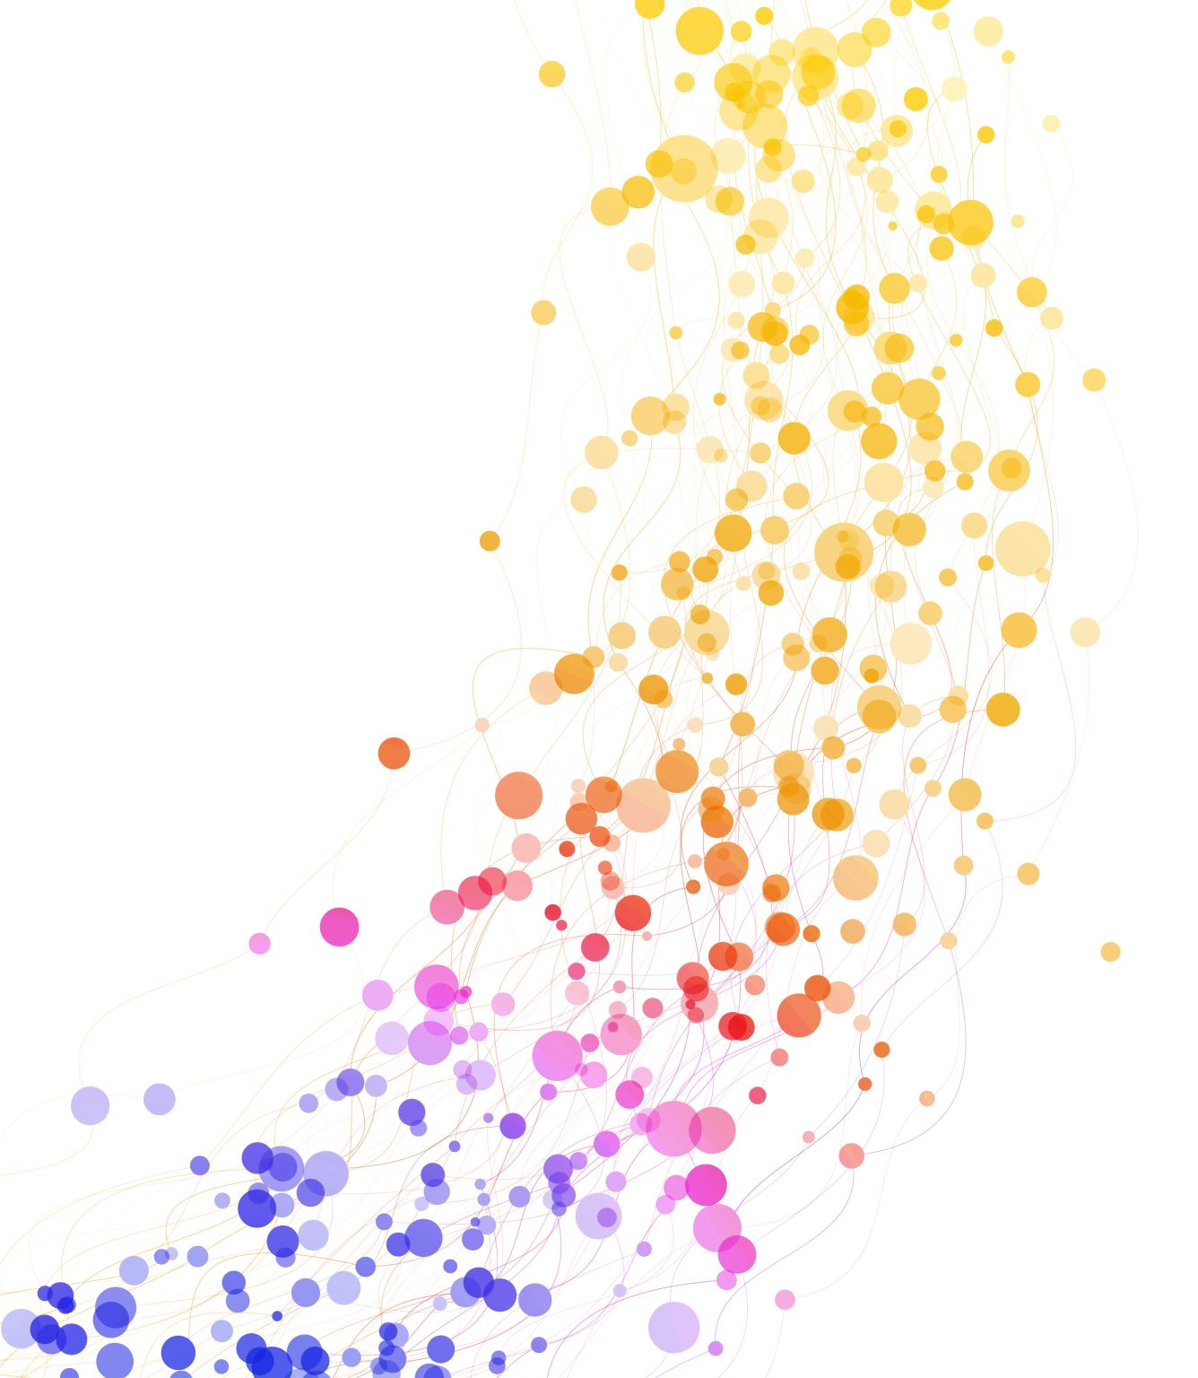
Introduction
Explanation of the object-oriented model

Slide 4
Entity
In data modelling, an entity is a clearly identifiable object through which information is to be stored or processed.
Examples: A vehicle, an account, a person, a condition.

Slide 5
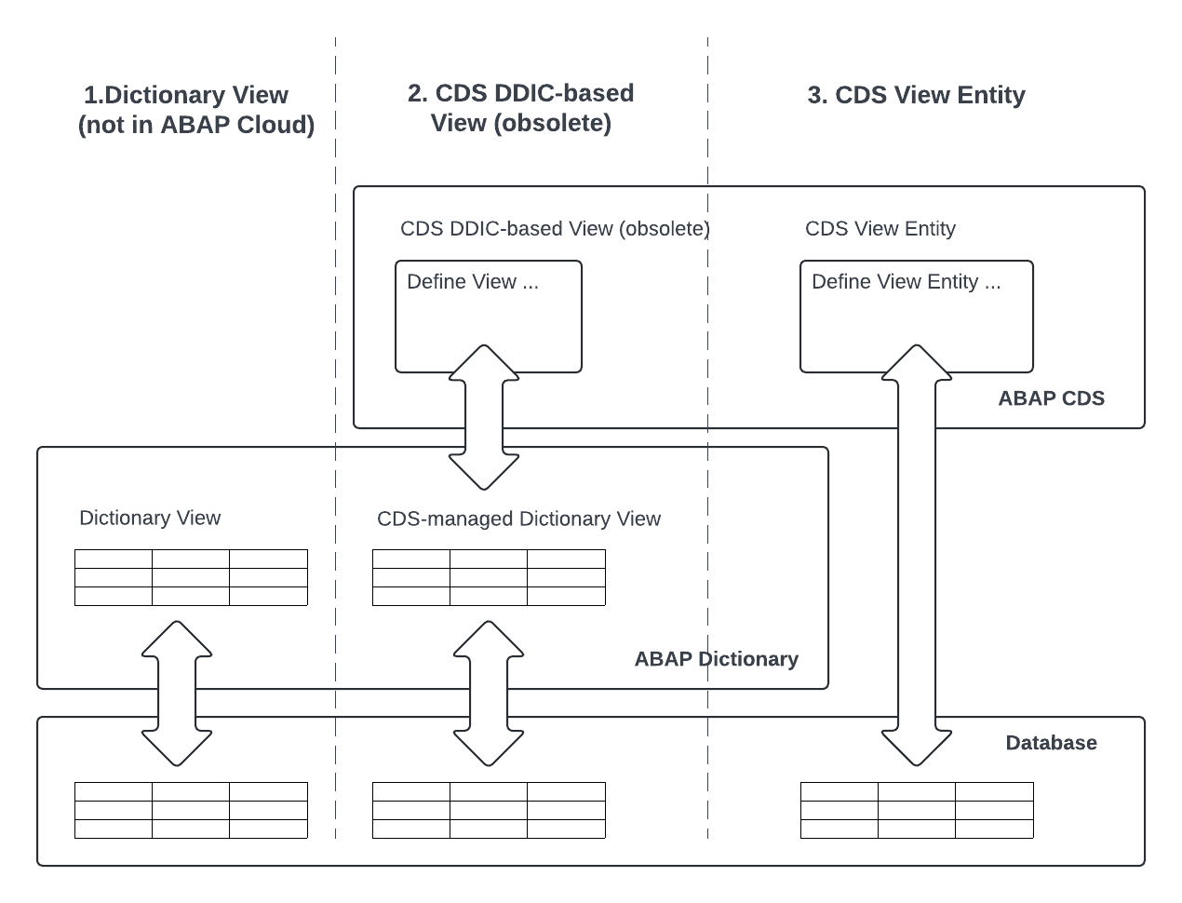
Types of CDS
CDS DDIC-based (obsolete)
uses a generated dictionary view as a technical representation for the database object.
Define View …
CDS-View Entity
Define the data object directly.
No DDIC object.
Define View Entity …

Slide 6
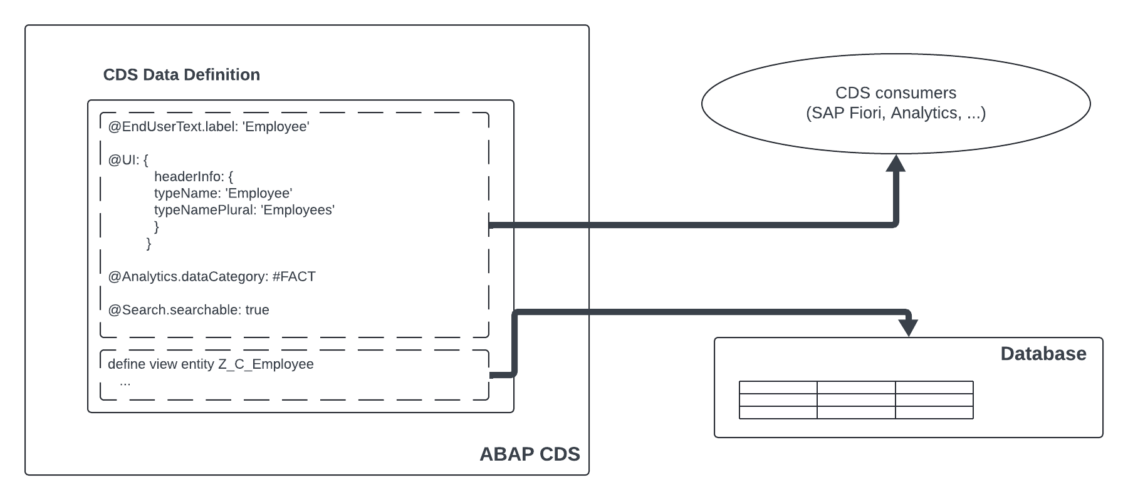
Not only technical definition of data objects
Technical definition
Annotations for enriching the technical view with semantic information (@...)
Only a few annotations are analysed by the ABAP system. The rest is passed on to the consumer.

Slide 7
Business object
Business object is a term used in object-orientated software development.
Business objects are used to model real variables and processes in information systems. In addition to data, they also contain the logic for processing them (this distinguishes them from entities).

Slide 8
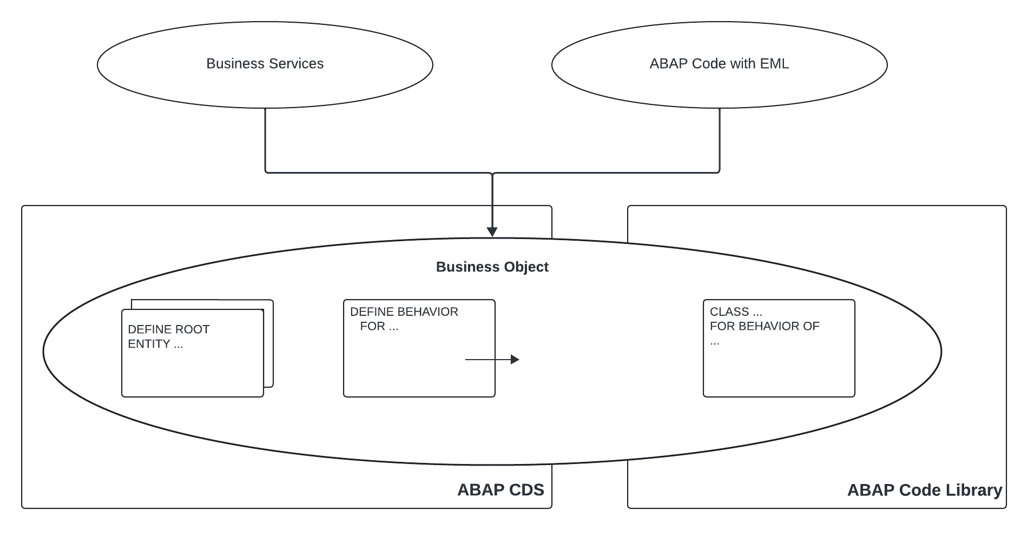
Business Object
Business objects are modelled with several CDS View entities.
CDS Behaviour for the transaction logic.
Implementing the transaction logic in a behaviour pool (ABAP class in the ABAP Code Library).
Business services consume BOs using OData Services, for example.
Access in ABAP code using Entity Modelling Language (EML).

Slide 9
ABAP CDS objects
Development Objects | Purpose | Info
CDS Data Definition | Defining a CDS entity | CDS Entities: CDS View Entity CDS DDIC-based Views (obsolete) CDS Projection Views CDS Abstract Entities CDS Table Functions CDS Custom Entities CDS Hierachies
CDS Access Control | Defining a CDS role | Read Acess Data
CDS Metadata Extension | Adding metadata for a CDS entity | Metadata for CDS Entity
CDS Behavior | Defining the behaviour of a BO | Used for transaction processing in RAP.

Slide 10
Introduction
ABAP 7.5x and Clean ABAP

Slide 11
Changes to ABAP 7.4 and 7.5
Changes Release 7.40, SP08
Changes Release 7.5x

Slide 12

Clean ABAP
Clean ABAP Styleguide
The aim of the guide is to support programmers in writing more efficient, more comprehensible and more robust code.

Slide 13
Introduction
Working with CDS Views

Slide 14
Hands On

Slide 15
Basic SQL Features
Practical exercise

Slide 16
Entity-Relationship-Modell
"Model for the representation of things/objects/objects and their relationships“
Semantic data modelling to determine and represent the relevant section of the real world in a given context (e.g. a project to create an information system).
The graphical representation of entity and relationship types is called an entity-relationship diagram (ERD) or ER diagram.

Slide 17
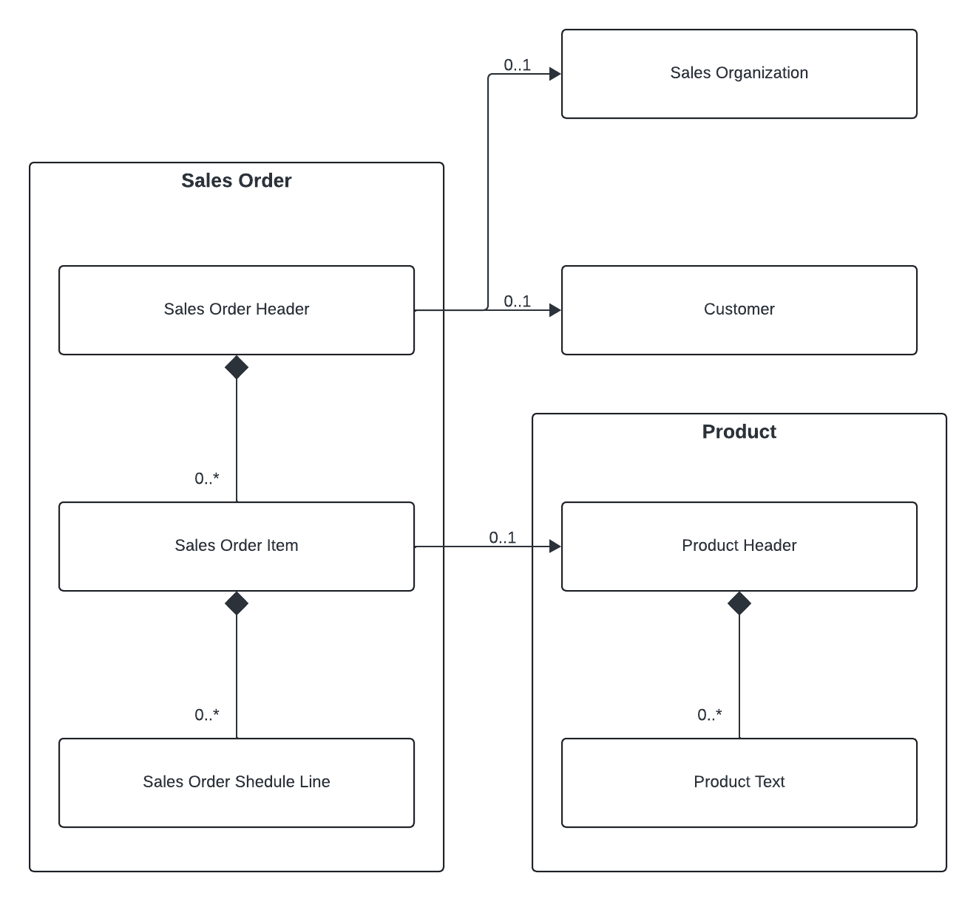
Define the data model
Object | Entity | DB Table | CDS View
Sales Order | Sales Order (header) | Z*SalesOrder | ZI_*SalesOrder
 | Sales Order Item | Z*SalesOrderItem | ZI_*SalesOrderItem
 | Sales Order Schedule Line | Z*SalesOrderSLine | ZI_*SalesOrderScheduleLine
Sales Organization | Sales Organization | Z*SalesOrg | ZI_*SalesOrg
Customer | Customer | Z*Customer | ZI_*Customer
Product | Product | Z*Product | ZI_*Product
 | Product Text | Z*ProductText | ZI*ProductText

Slide 18
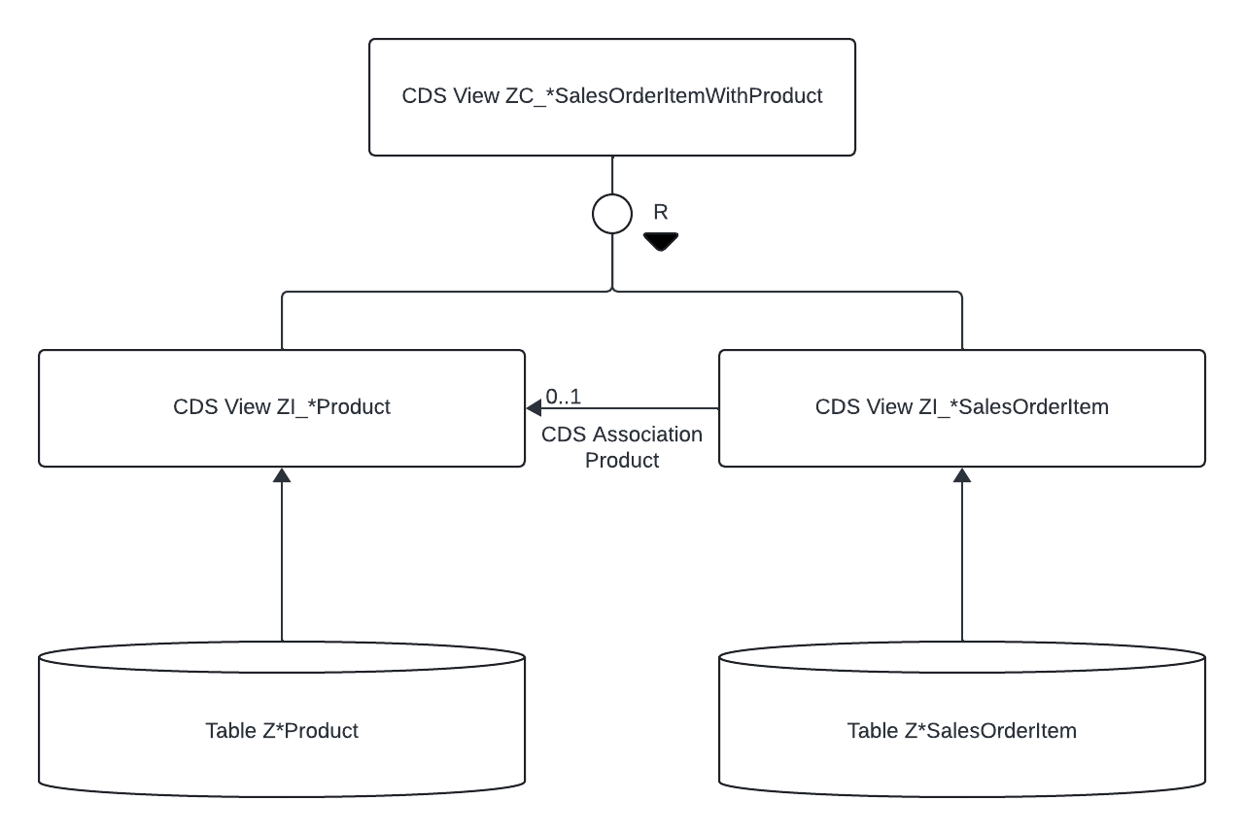
Define the data model

Slide 19
Hands On
Create and fill database table

Slide 20
Hands On
Create simple CDS views

Slide 21
Difference between associations and joins
"Join on demand“
Technically, both options are similar. The main difference is that the tables linked via the association are only selected if the caller (e.g. the SELECT statement in ABAP) wants at least one field from the related table.

Slide 22
Hands On
Create associations

Slide 23
Root entity
With a root view entity, we can now define each view entity as a possible business object (BO).
This BO can later be used in SAP RESTful application programming.

Slide 24
Hands On
Root entity

Slide 25
Association and composition
A CDS composition is a specialised/stricter form of CDS association that defines the CDS entity as the superordinate entity of the composition target.
The target entity of the composition is the subordinate entity and must define a TO-PARENT association to its superordinate entity.
Existential dependency, which is also important for us in the RAP context.

Slide 26
Hands On
Create compositions

Slide 27
Quiz
What is an entity?
What is a BO?
What is the difference between a CDS view with "define view..." and "define view entity...".
What are associations? Draw a comparison with a conventional join.
What are compositions used for?
Describe the basic structure of a CDS.
What are annotations used for?

Slide 28
SQL Features
Practical exercise

Slide 29
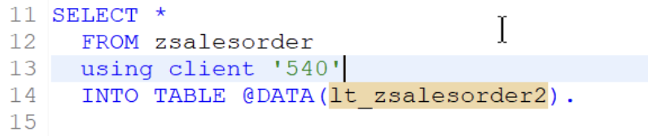
Hands on
Test whether cross-client selections on CDS views are also possible.
Create a report for this purpose.
Use a CDS you have created.

Slide 30
Hands on
Write a report with a select that shows values from the sales order item and the product header.

Slide 31
Hands On
Write a programme that selects the data from the Sales Order Sheduleline.
Return data from the header, the items, the product and the product text.
What are you missing in the product text?
How can the problem be avoided?

Slide 32
Hands On
Take a look at the CDS view Z_ViewWithOptionalParameters.
Write a report that uses a select with today's system date: Select * from ... ( p_parameter = ... )
Also use the other parameters in your report.

Slide 33
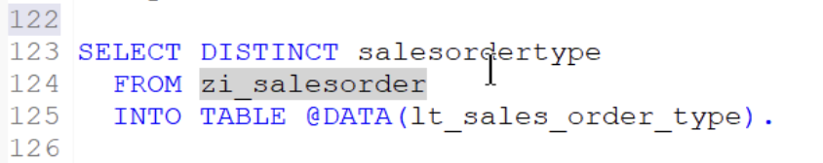
Hands On
Write a report that performs a Select Distinct.
What is Distinct used for?
Write a CDS view that uses the Distinct command.

Slide 34
Hands On
Write a CDS view as a select on Z_ViewAsDataSourceD.
Set a LEFT outer join to Z_ViewAsDataSourceD and the fields FieldD2 = FieldE1.
Write a CDS that converts the left outer join as an association.

Slide 35
Hands On
Look at the CDS view from the selection.
Write a report with this select and compare the fields castchar and numc000 in the result (IF statement)... via EQ.
Additional task: Write a CDS view that selects ZI_SFLIGHT but converts the timestamp into a date.

Slide 36
Hands on
Take a look at ZI_PRODUCTS_000.
Briefly describe what this view represents.

Slide 37
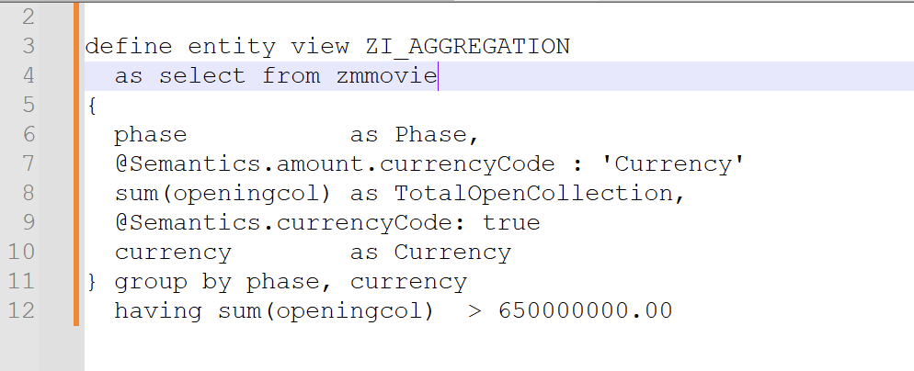
Hands On
Write a similar view which selects from ZI_PRODUCTS_000.
Use a parameter for having sum.
Pass the parameter from a report using the selector.

Slide 38
Hands On +
Open ZC_SalesOrderWitthUserInput2
What happens if I make the following select: SELECT * FROM zc_salesorderwithuserinput2( p_userinput = ‘TAF‘ ) INTO TABLE ... .

Slide 39
Brainstorming
Daily summary

